Slide 1
CAP476:
Data Communication and Networking
Unit-I
Network Basics

Slide 2
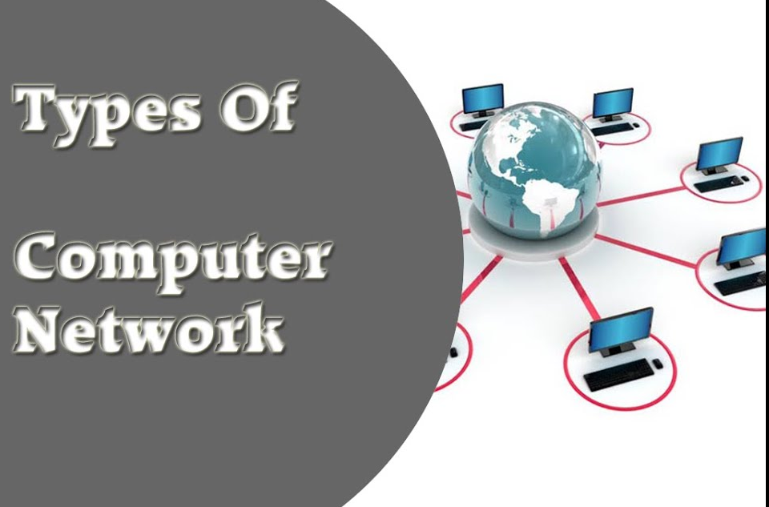
Computer Networks

Slide 3
Categories of Networks
Personal Area Network (PAN)
Local Area Network (LAN)
Wireless Local Area Network (WLAN)
Metropolitan Area Network (MAN)
Wide Area Network (WAN)

Slide 4
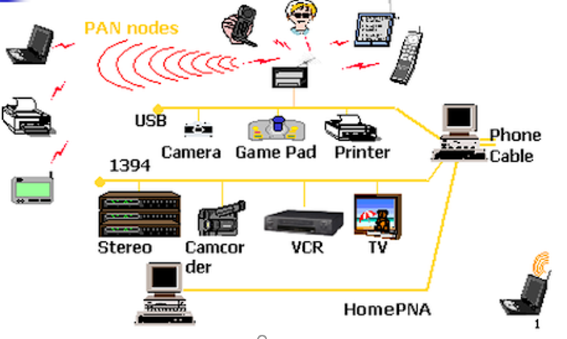
Personal Area Network (PAN)
Short-range, individual device connection
Typical range: few meters
Devices: smartphones, laptops, wearables
Used for personal data transfer
Example: Bluetooth, USB networks

Slide 5
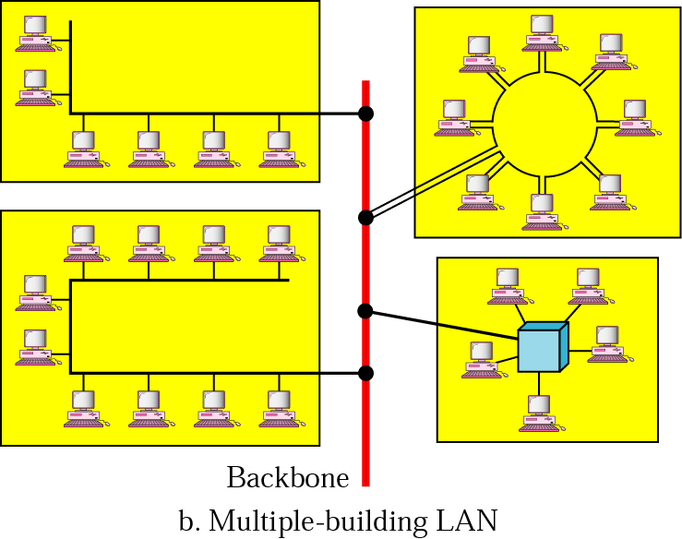
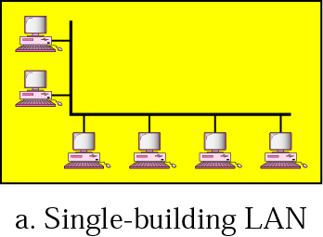
Local Area Network (LAN)
Covers small geographic area
Connects computers in offices, schools
Privately owned, managed by organization
Uses Ethernet, Wi-Fi technologies
High speed, easy resource sharing

Slide 6
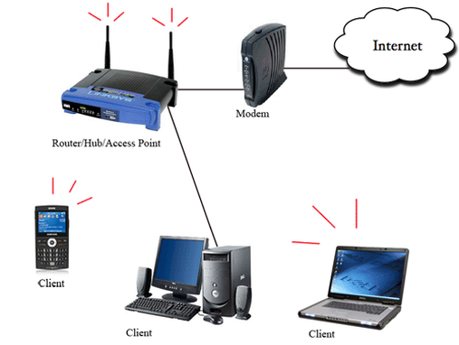
Wireless Local Area Network (WLAN)
LAN using wireless signals
Uses radio waves (Wi-Fi)
Devices connect without cables
Supports mobility within network
Examples: wireless routers, hotspots

Slide 7
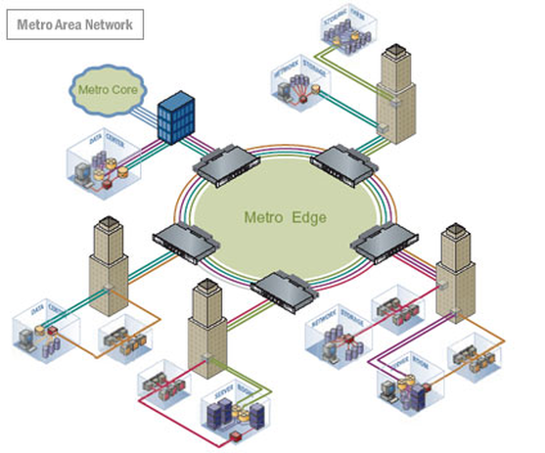
Metropolitan Area Network (MAN)
Spans a city or campus
Larger than LAN, smaller than WAN
Owned by single organization/government
Used for citywide connectivity
Connects multiple LANs together

Slide 8
Wide Area Network (WAN)
Largest network type by size
Connects LANs/MANs globally
Uses public/private transmission providers
Slower than LAN, expensive infrastructure
Example: the Internet, corporate WANs

Slide 9
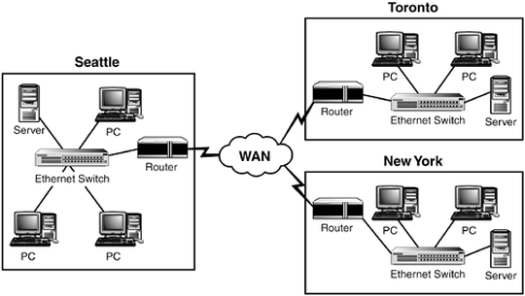
Wide Area Network (WAN)

Slide 10
THANK YOU

